Slide 1
Bipolar Transistor (BJT)
Circuit Structure and Physical Properties
BJT Working Region
BJT Biasing Circuits
Current mirrors

Slide 2
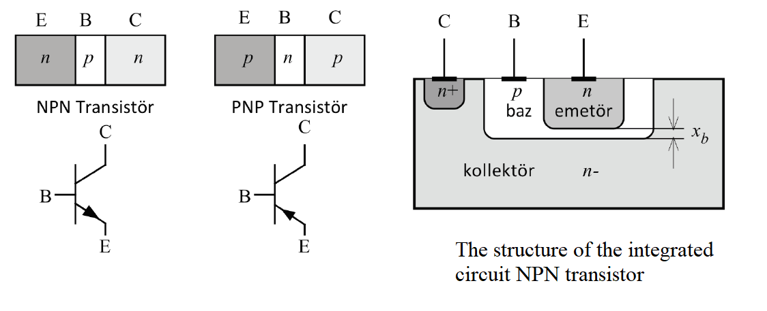
NPN and PNP bipolar transistor structure circuit diagram

Slide 3
Bipolar Transistör
Bipolar transistors can have two different structures, NPN and PNP.
Their working principles are the same.
In NPN transistors, current carriers are electrons. So these transistors are faster.

Slide 4
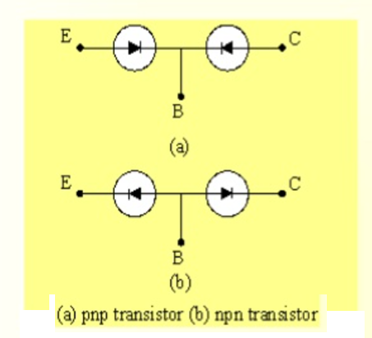
Bipolar Transistör
The bipolar transistor can be thought of as two diodes connected in the opposite direction.
In the normal operation of the bipolar transistor, the base-emitter junction is forward biased.
The base-collector junction is reverse biased.

Slide 5
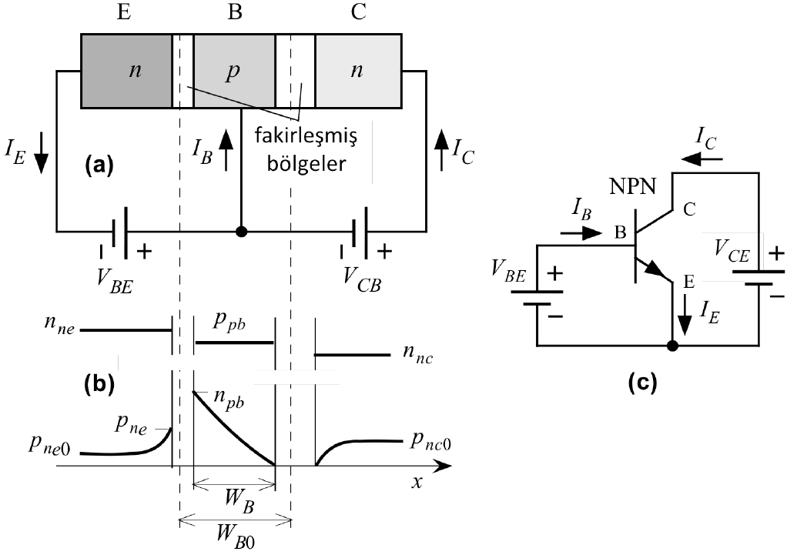
Transistor Working Principle
Doping concentration of the emitter, base and collector regions are different.
The most doping region is the emitter region.(N≈1019).
The base region is less doped (N≈1017) and the collector region is least doped (N≈1015).
Base region width should be shorter than L diffusion length.
a) Structure of bipolar transistor b) carrier density c) circuit diagram

Slide 6
Transistor Working Principle
The electrons that pass into the base region are minority carriers here and begin to merge with the holes, which are the majority carriers here, and their number decreases as they move towards the collector side.
However, since the base region width is very short and the hole density in the base region is too low than the electron density in the emitter, most of the electrons entering the base region manage to arrive at the collector junction.
The electrons that reach here are rapidly attracted towards the collector side by the electric field created by the positive potential in the collector and they form the collector current by joining the electrons that are the majority carrier here.

Slide 7
Transistor Working Principle
The emitter current is approximately equal to the collector current since most of the carriers passing from the emitter to the base region reach the collector region.
The few electrons are combined with holes in the base constitutes the base current. In this case, the base current is too small compared to the collector current.
On the other hand, the collector current is directly proportional to this small base current and the base current controls the collector current.

Slide 8
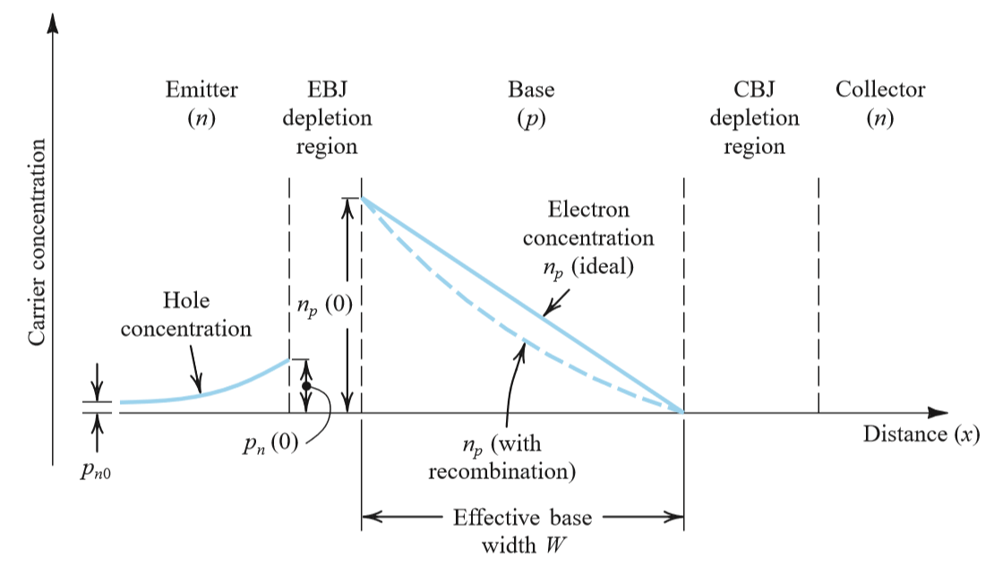
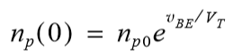
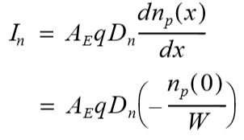
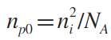
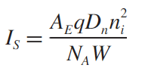
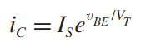
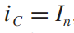
Calculation of Base and Collector Currents

Slide 9
Calculation of Base and Collector Currents
If the base region (WB) is larger than the Ln diffusion length, all electrons entering the base region combine with the holes and disappear. Hence, the collector current becomes zero. On the other hand, WB << Ln, very few electrons coming from diffusion combine with holes and 98% to 99.8% of these (this amount depends on base region doping concentration and WB / Ln ratio) creates collector current.
Electrons combined with holes in the base region also form the base current..
In this case, the following relations can be written.
IE = IB+IC
IC = IE − IB =αFIE ≈ IE

Slide 10
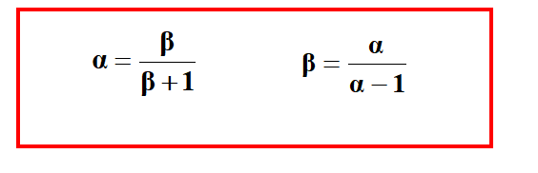
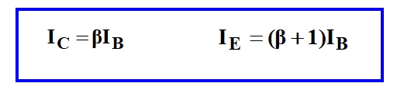
Calculation of Base and Collector Currents
Since IB << IE, the αF coefficient (current gain from emitter to collector) in this equation is less than one but very close to one and its value varies between 0,980… 0,998.
IE = IB+IC If the value of the base current is calculated from its equation, the relation between the collector current and the base current is found below:

Slide 11
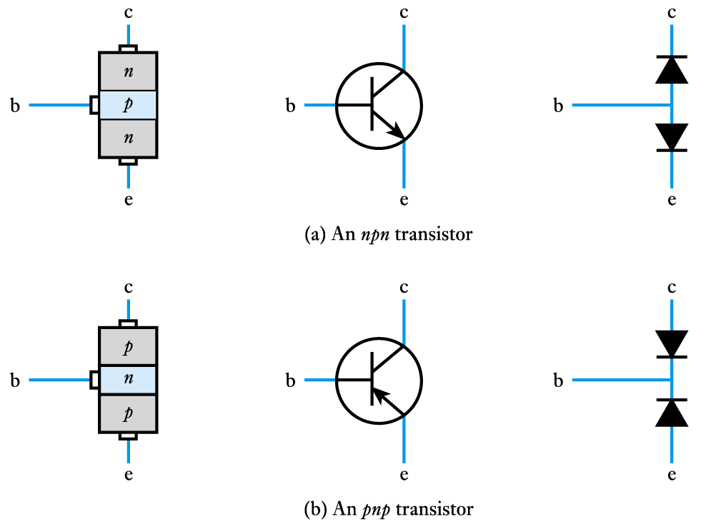
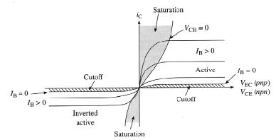
Bipolar Junction Transistors: Operation Modes
Saturation : In this method both the junctions are forward biased. This method is not useful as the transistor is in “saturation” and the current cannot be controlled easily.
Cutoff: In this method both the junctions are reverse biased. This method is also not useful as the transistor is in “cut-off” state since current is zero.
Active: This is the most common and popular method used in transistor biasing. In this method, the base-emitter junction is forward biased and collector-base junction is reverse biased. So by adjusting base voltage we can control total current in the transistor easily.
Bias Mode | E-B Junction | C-B Junction
Saturation | Forward | Forward
Active | Forward | Reverse
Cutoff | Reverse | Reverse
Operational modes are defined based on V_{BE} and V_{BC}

Slide 12
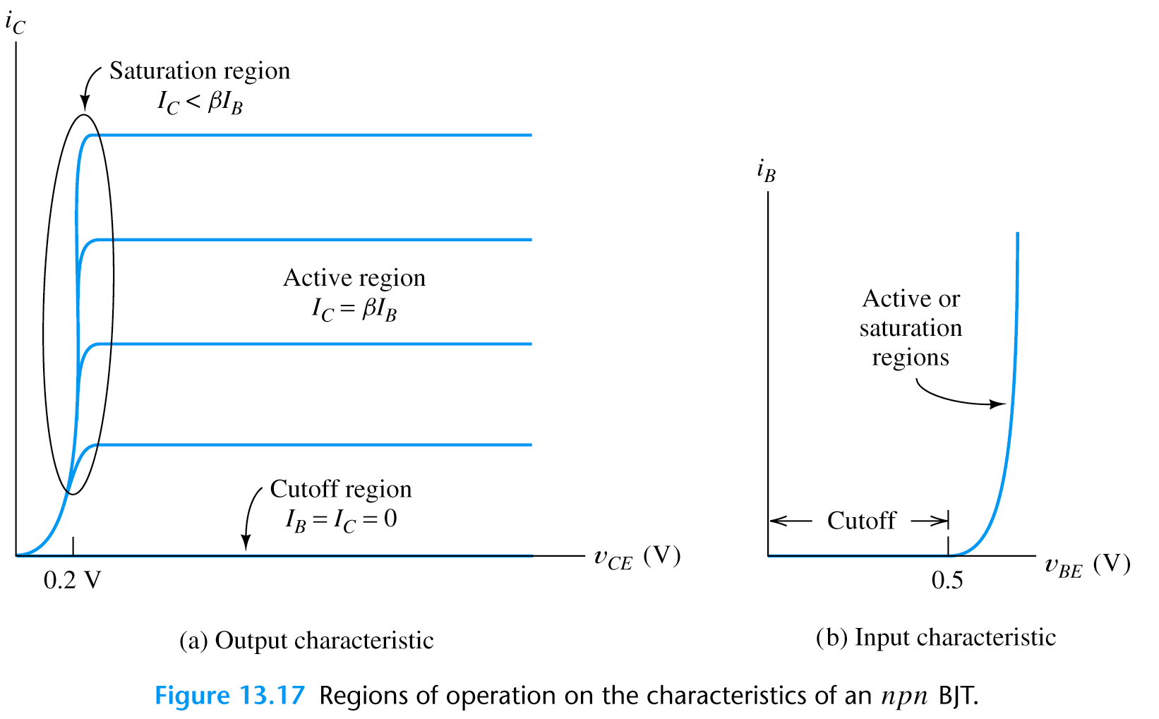
BJT Operating Regions and I V Curves
Output characteristics
region near to the origin is the saturation region
this is normally avoided in linear circuits
Input characteristics
the input takes the form of a forward-biased pn junction
the input characteristics are similar to a semiconductor diode

Slide 13
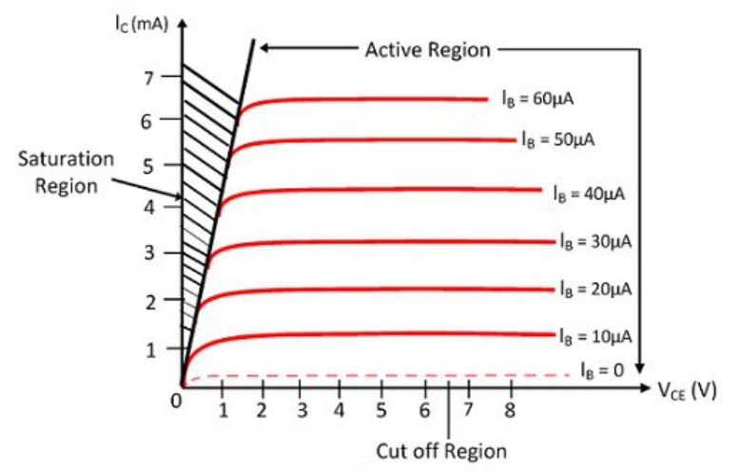
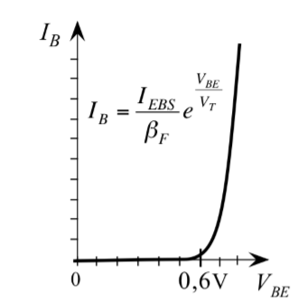
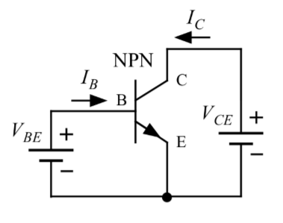
Input-Output Characteristics of BJT
Output Characteristic
Input Characteristic

Slide 14
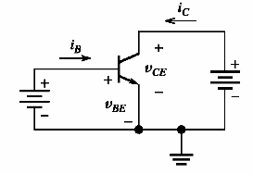

BJTs – Current & Voltage Relations
Operation Mode: v_{BE} forward biased & v_{BC} reversed biased (Aktif mod)
Shockley equation
$$V_{CE}>V_{BE}$$
I_{ES}=saturation current (10⁻¹²-10⁻¹⁶A); V_{T}=kT/q -termal voltage (26mV)
Kirchhoff Law
Current Gain

Slide 15
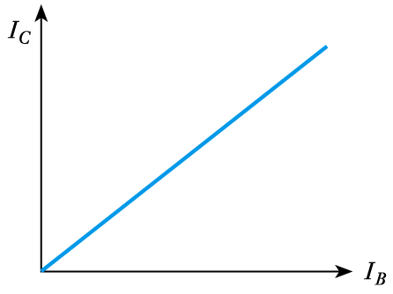
The relationship between collector and base currents
The characteristic is almost linear.
Generally, the value of the collector current is much higher than the base current.
The transistor provides current gain.

Slide 16
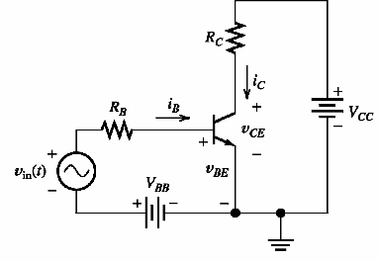
BJT Load line analysis
V_{BB}/R_{B}
v_{BB}
Loop equation
For i_{B}=0
For v_{BE}=0

Slide 17
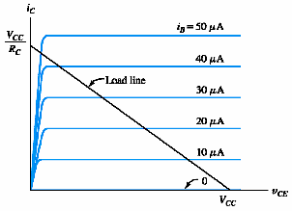
BJT Load line analysis
Loop Equation

Slide 18
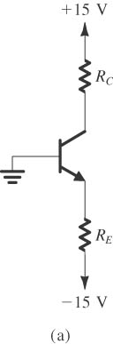
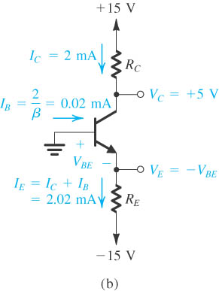
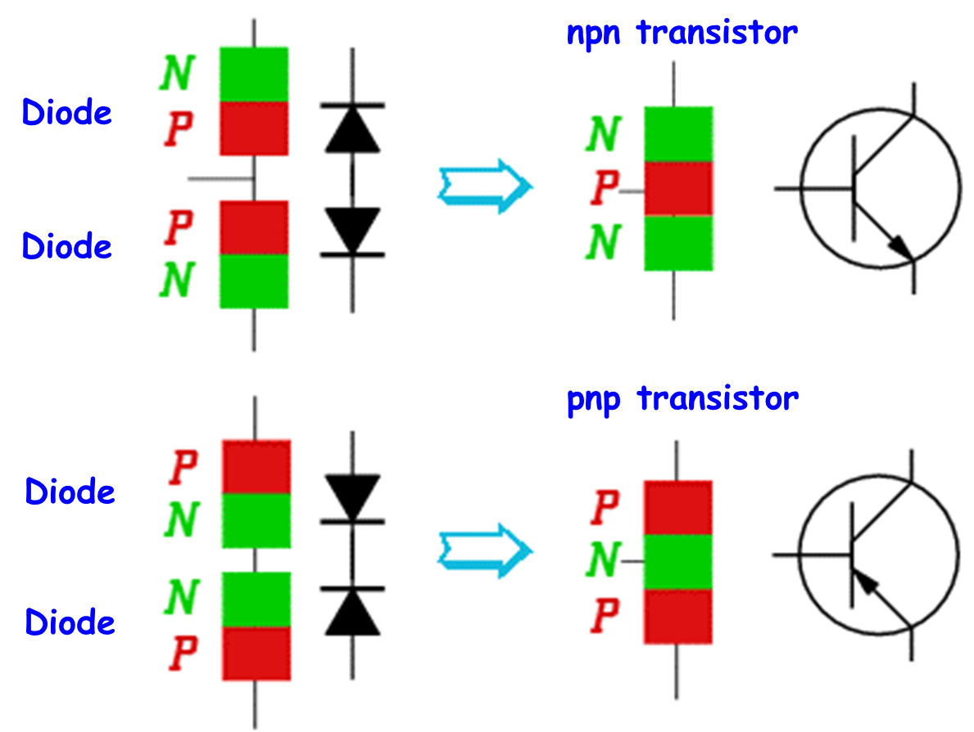
Sample : Find the IC and VC values by analyzing the circuit given below (a). For transistor in active region β = 100 and |V_{BE}| = 0.7V . (RC = 5kΩ, RE = 7.07kΩ)
Notes:
sedr42021_0515a.jpg

Slide 19
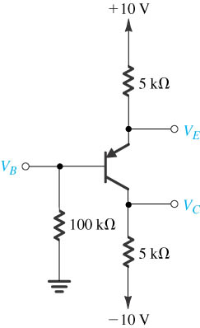
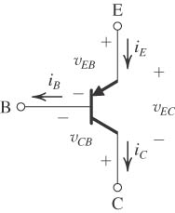
Sample :
Find the IC and VE values by analyzing the circuit given below (a). For transistor in active region β = 100 and |V_{BE}| = 0.7V .
Notes:
sedr42021_0515a.jpg

Slide 20
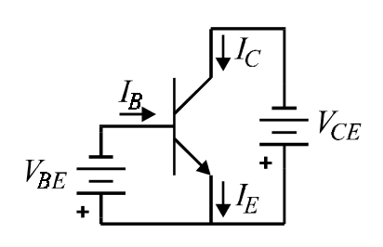
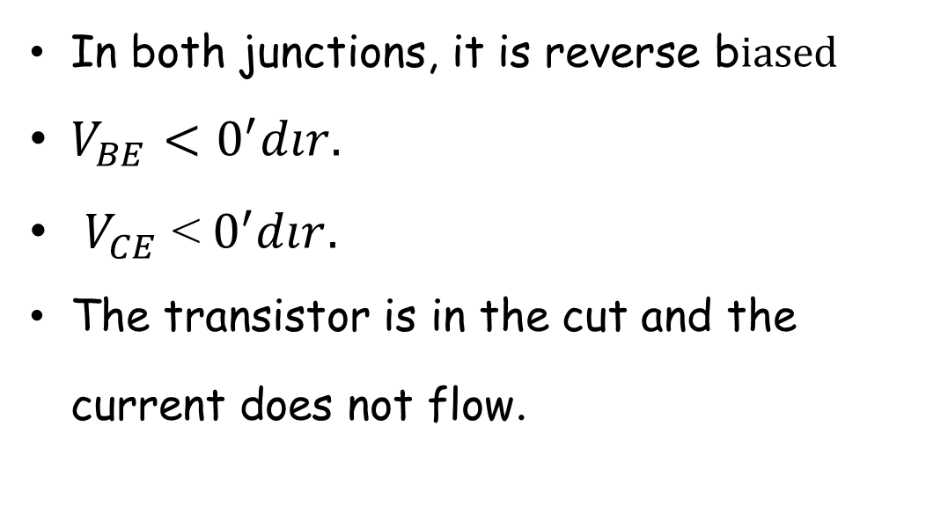
Transistor Working in Cutoff
In both junctions, it is reverse b$iased$
$V_{BE}<0^{′}dır.$
$V_{CE}$ <${ 0}^{′}dır.$
The transistor is in the cut and the current does not flow.

Slide 21
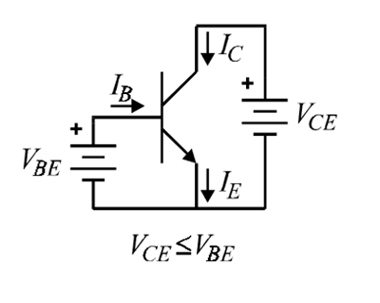
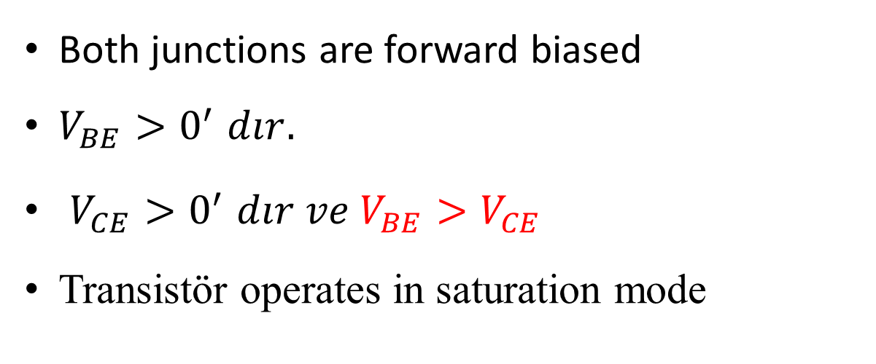
Transistor Saturation Operation
Both junctions are forward biased
$V_{BE}{>0}^{′}dır.$
$V_{CE}{>0}^{′}dır ve V_{BE}{>V_{CE}}^{}$
Transistör operates in saturation mode
$V_{BE}$=$V_{CE}$ is baundary condition

Slide 22
DC bias circuits for BJT
Identification and analysis of the operation of various biaising circuits:
Base bias circuits
Bias circuits with voltage divider
Emitter bias circuits
Bias circuits with Collector feedback
Bias circuits with emitter feedback

Slide 23
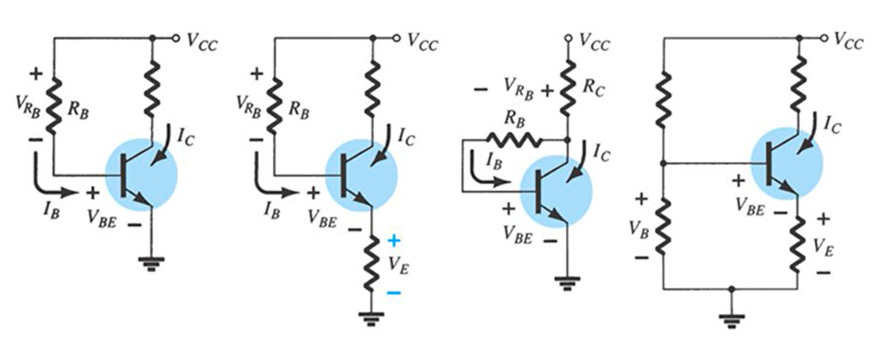
DC Bias circuits for BJT

Slide 24
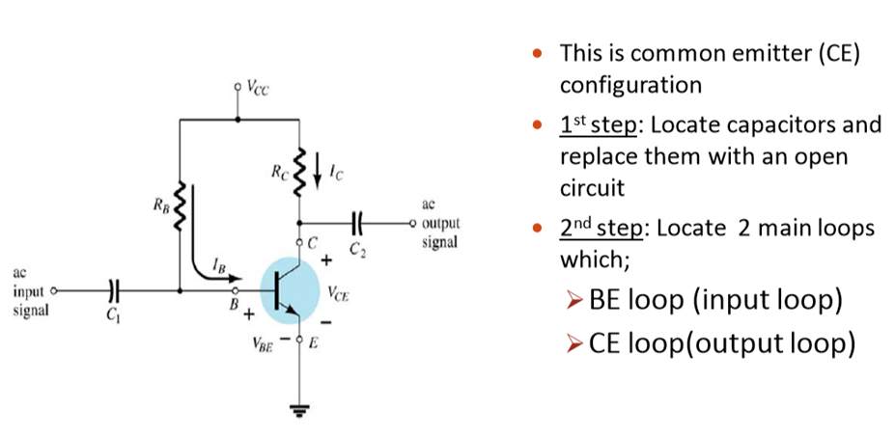
BIAS CIRCUITS
1. (sabit kutuplama), FİXED BİAS CİRCUİT).

Slide 25
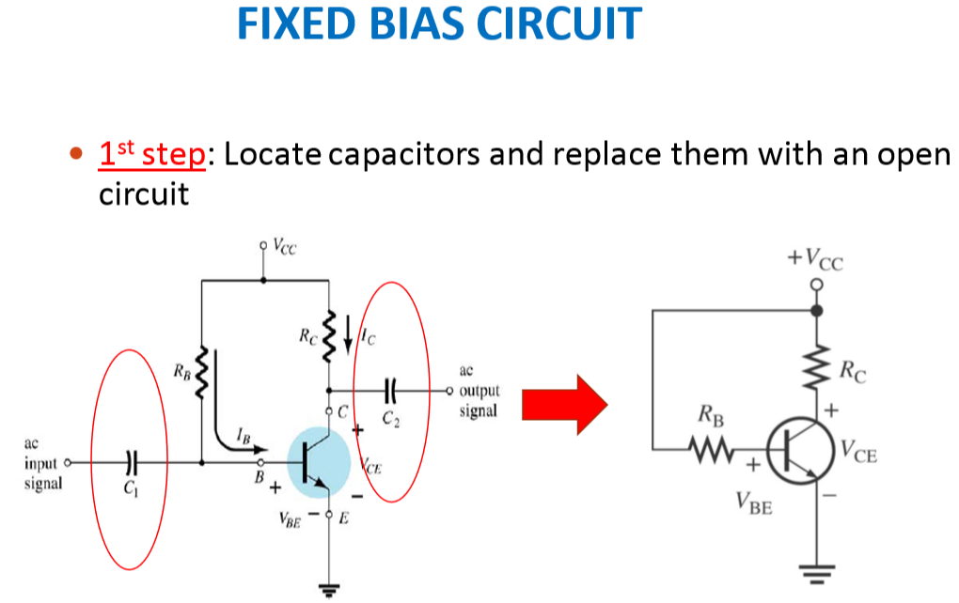

Slide 26
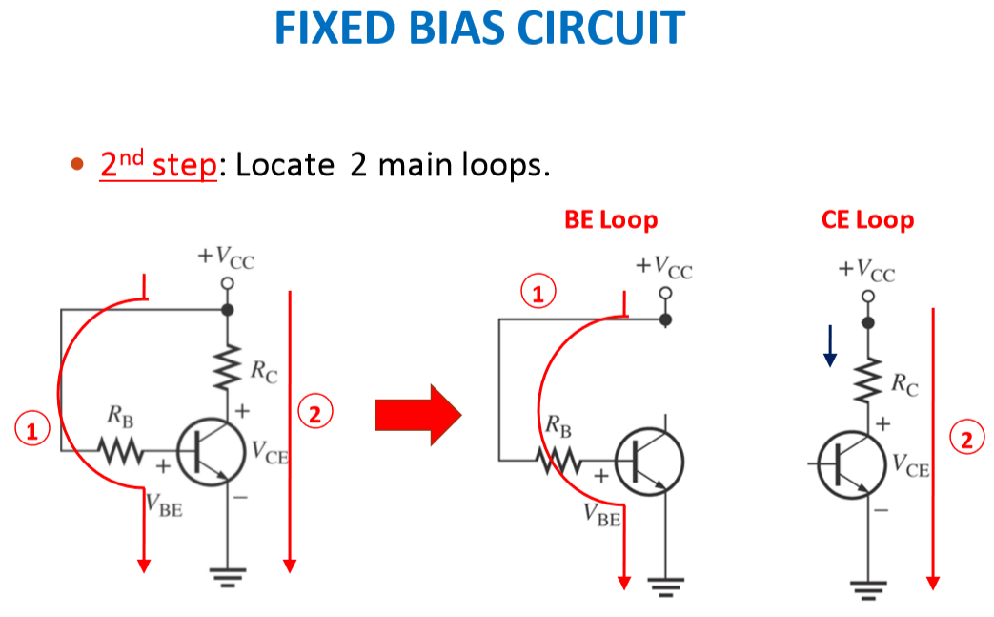

Slide 27
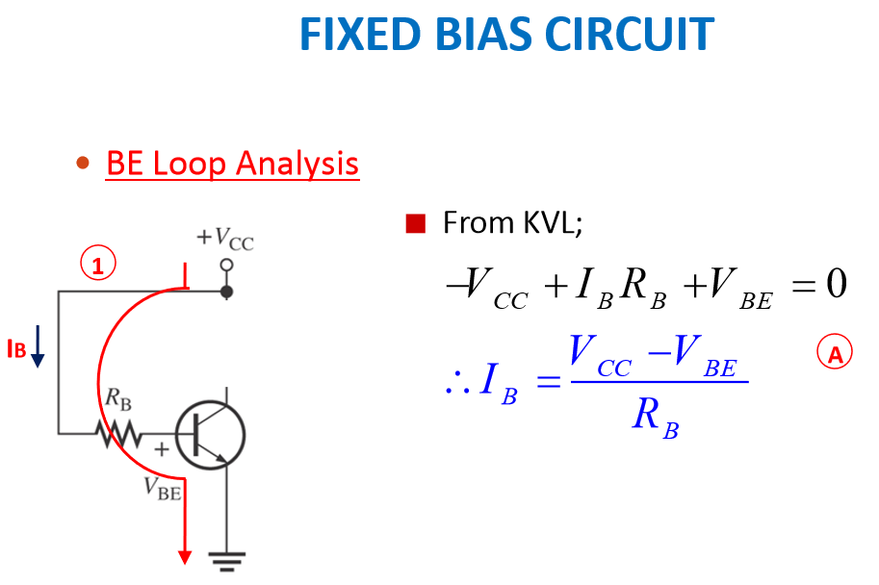

Slide 28
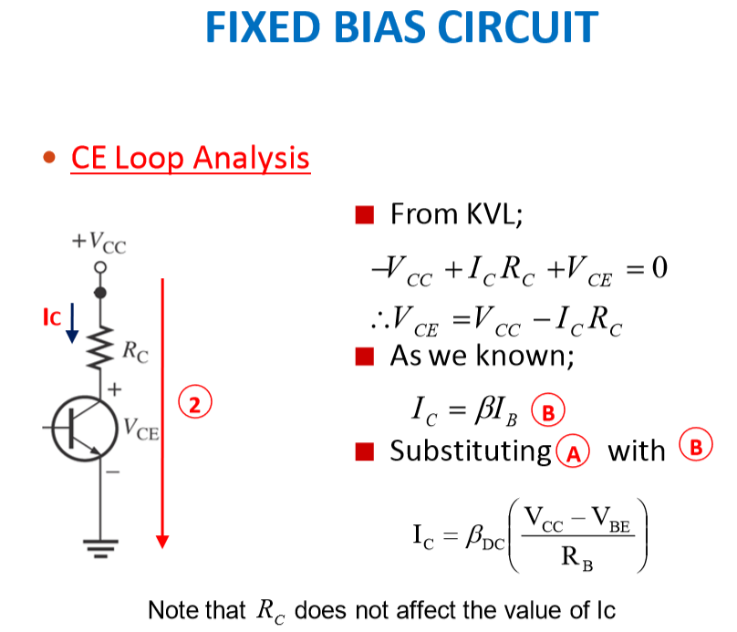

Slide 29
Sample
Draw the DC load line for the circuit in the figure and mark the working point (Q). Determine if the circuit is biased at the midpoint.

Slide 30
Sample
Circuşt is biased at the midpoint

Slide 31
(shift of the working point)
In the circuit shown, the transistor has hFE = 100 for T = 25 ° C and hFE = 150 for T = 100 ° C. Determine the operating point IC and VCE values for both temperature values. VBE = 0.7V
Temp(°C) | I_{B} (μA) | I_{C} (mA) | V_{CE} (V)
25 | 20.28 | 2.028 | 3.94
100 | 20.28 | 3.04 | 1.92
Q(100⁰C)
(25⁰C)

Slide 32
Base bias characteristics.
Circuit recognition: Single resistance (RB) between power supply (VCC) and base. There is no resistance in the emitter.
Advantage: the circuit is simple.
Disadvantage: Working point depends on temperature changes.
Applications: Switching circuits.

Slide 33
Base bias characteristics.
Load line equations:
Maksimum I_{c} current
Operating point equations:

Slide 34
2. (Gerilim bölücülü kutuplama)Voltage divider bias circuit.
1. Step: The circuit is rearranged so that all capacities are open circuit:

Slide 35
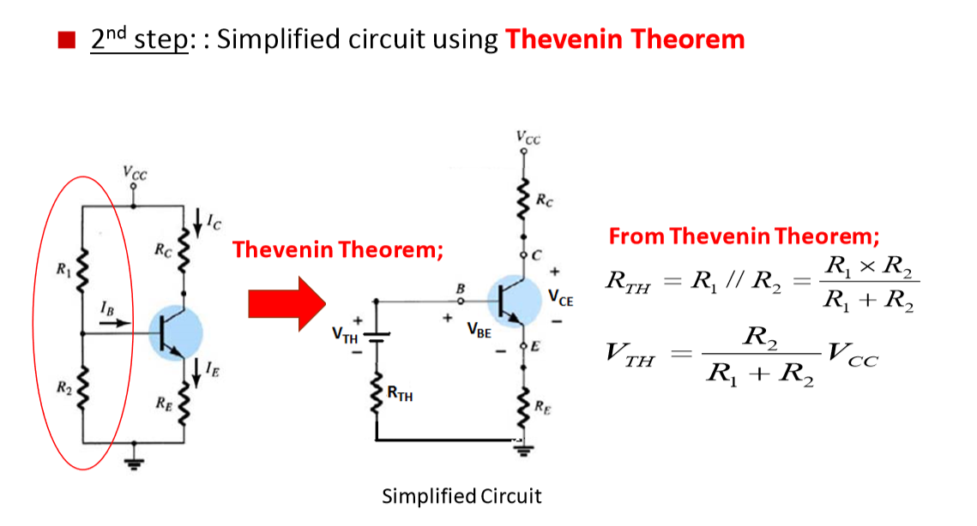
2. Gerilim bölücülü kutuplama (Voltage divider bias circuit).

Slide 36
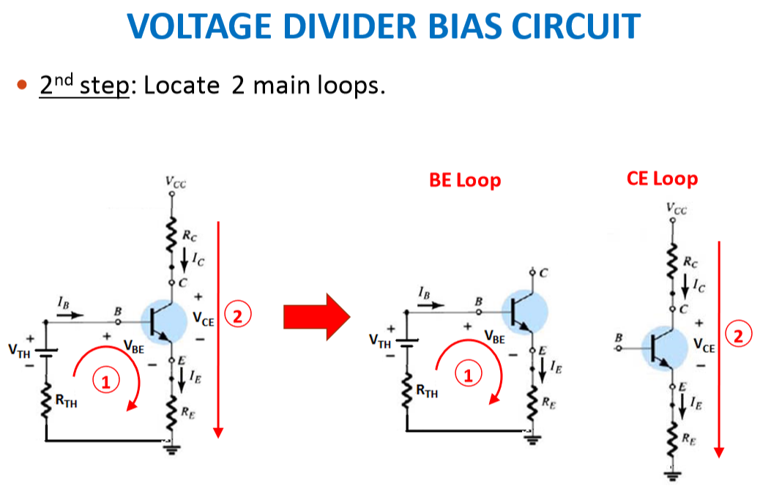

Slide 37
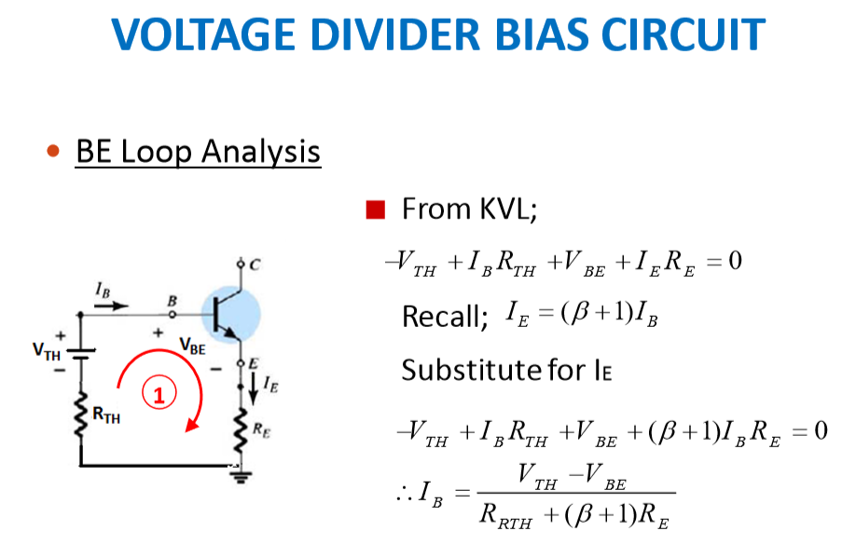

Slide 38
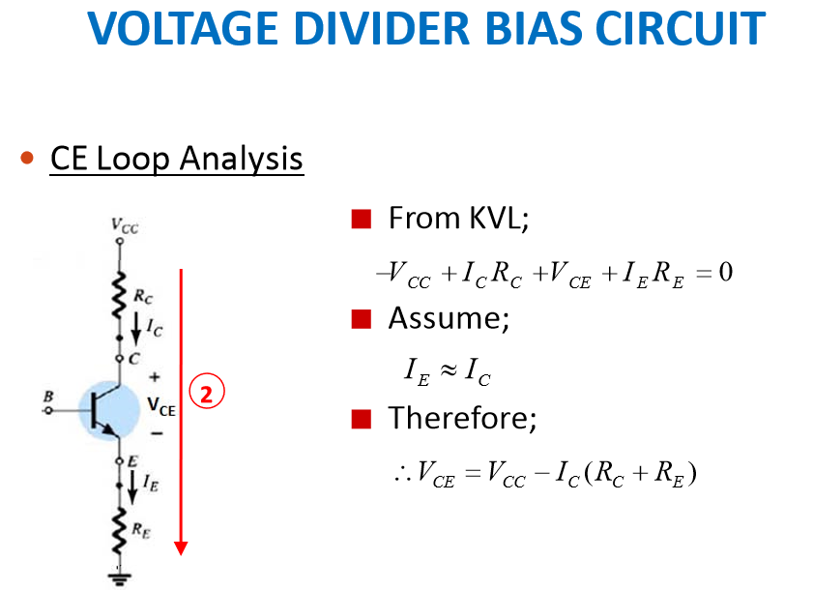

Slide 39
Stability of the voltage divider bias circuit
In the bias circuit with voltage divider, the hFE dependence of the operating point is less than that of the base bias circuit.
For example, I_{E} 10 mA , h_{FE} changes between 100 and 300
As can be seen, despite the great change of hFE, ICQ changes little.

Slide 40
the voltage divider bias circuit characteristics.
Circuit recognition: Voltage divider in the base circuit.
Advantages: The working point of the circuit is not sensitive to hFE changes (stable).
Disadvantages: It needs more elements than most biased circuits.
Applications: It is primarily used to bias linear amplifiers.

Slide 41
Sample
|V_{BE}| = 0.7V
Find the value I_{CQ} ve V_{CEQ}.
I_{CQ} @ I_{E} (veya h_{FE} >> 1) olduğundan,

Slide 42
3. Emmiter biasing.
Assuming the transistor operates in the active region;
For h_{FE} >> 1,

Slide 43
Line load for the emitter bias circuit

Slide 44
Emitter biasing characteristics.
Circuit recognition: Symmetrical (positive and negative) supply source and base resistance is grounded.
Advantages:The working point of the circuit is not sensitive to hFE changes (stable).
Disadvantages:Needs symmetrical (positive and negative) supply source.
Apllications:It is primarily used to biase linear amplifiers.

Slide 45
Emitter biasing characteristics.
Load line equations:
Working point equations :

Slide 46
Sample
Find the value of I_{CQ} ve V_{CEQ}

Slide 47
4. Collector feedback bias

Slide 48
Örnek
Find the value of I_{CQ} ve V_{CEQ}

Slide 49
Stability of the collector feedback bias circuit
h_{FE} increases
I_{C} increases (I_{B} at the same value)
V_{CE} decrease
I_{B} decrease
I_{C} it doesn't increase much.
Stability is good. Sensitivity to hFE and temperature changes is low.

Slide 50
Collector feedback bias characteristics
Circuit recognition: Base resistance connected between the base and the collector.
Advantages: Having a simple bias circuit with relatively stable operating point.
Disadvantages: Relatively weak (bad) AC characteristic
Applications: It is primarily used to bias linear amplifiers

Slide 51
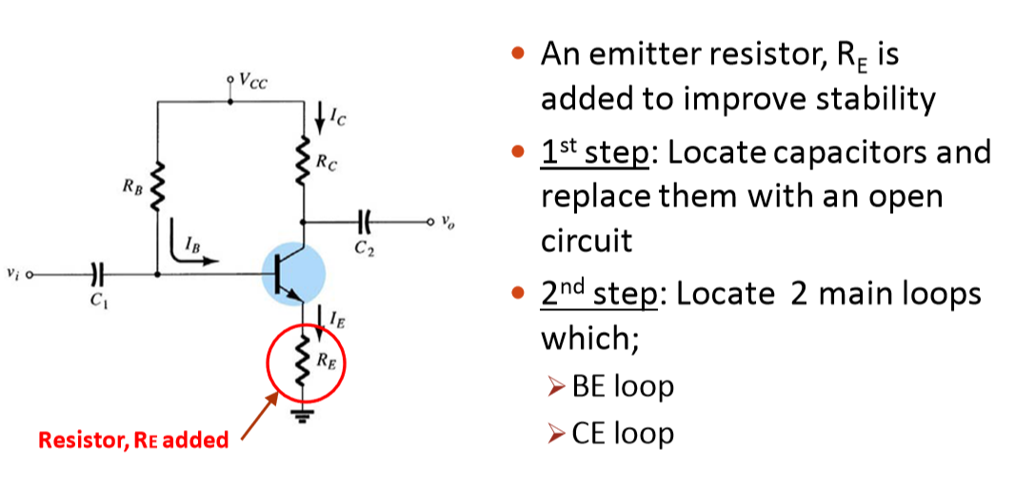
5. Emiter Geribeslemeli kutuplama (Emitter Stabilized Bias Circuit)

Slide 52
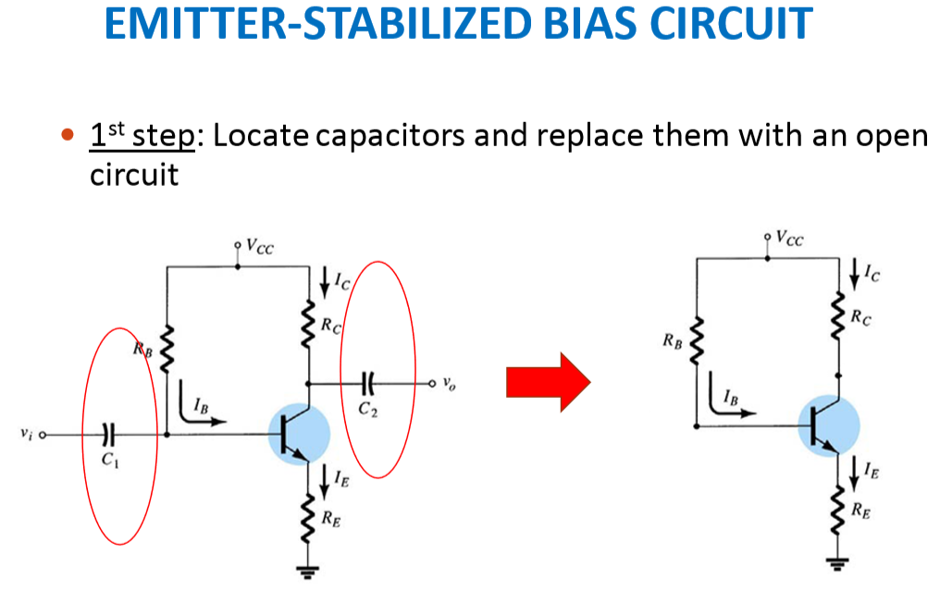

Slide 53
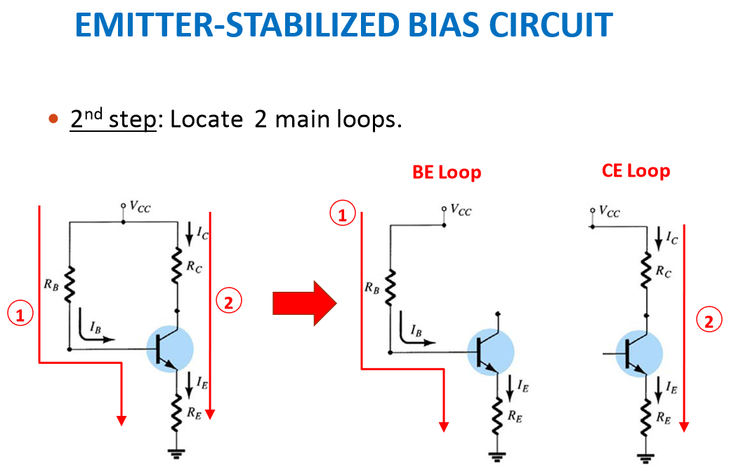

Slide 54
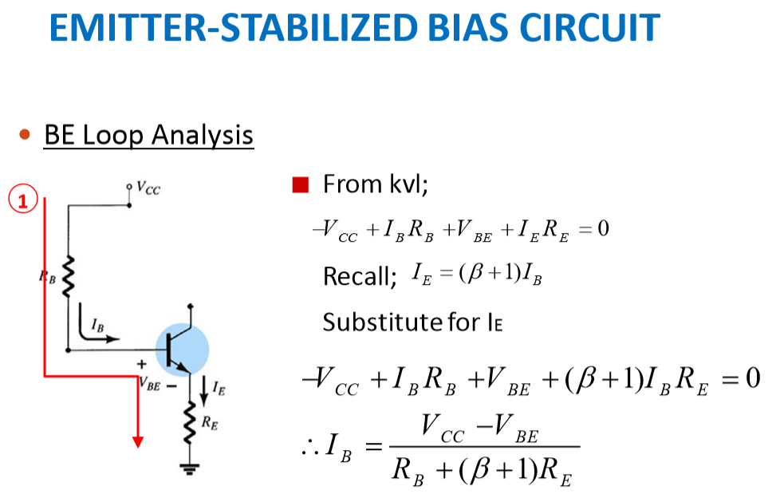

Slide 55
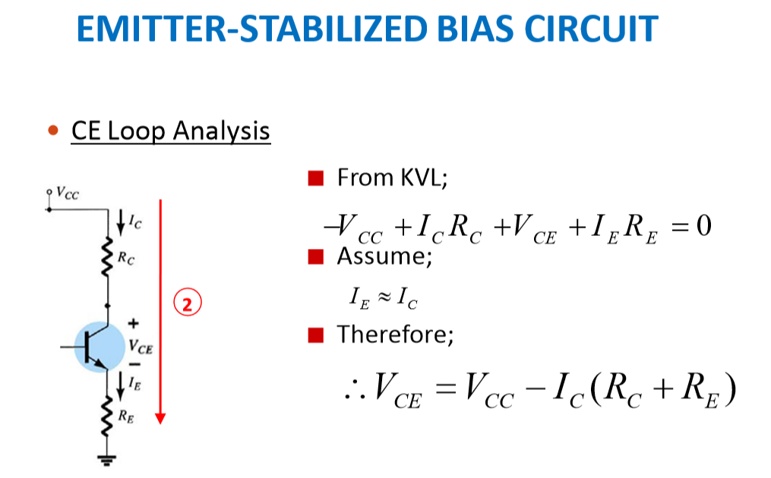

Slide 56
5. Emmiter stabilized bias circuit

Slide 57
Sample

Slide 58
Stability of the emitter stabilizied bias circuit
h_{FE} artar
I_{C} artar (I_{B} aynı değerde iken)
V_{E} artar
I_{B} azalır
I_{C} çok fazla artmaz.
Kararlılığı iyidir. I_{C} değerinin h_{FE} ve sıcaklık değişimlerine duyarlığı azdır.

Slide 59
Emmiter stabilized bias circuit characteristics
Recognition of the circuit: It is similar to the voltage divider polarization circuit but R2 resistance is missing (or RE added base bias circuit).
Advantages: Having a simple biasing circuit with relatively stable operating point.
Disadvantages: It needs more elements than the collector feedback bias circuit.
Applications: It is primarily used to biaslinear amplifiers.

Slide 60
Emmiter stabilized bias circuit characteristics
Working point equations:

Slide 61
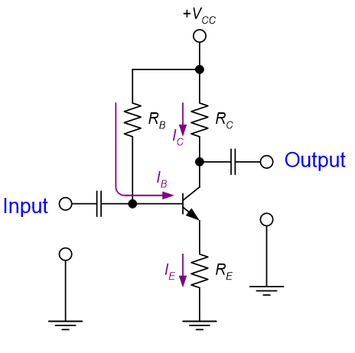
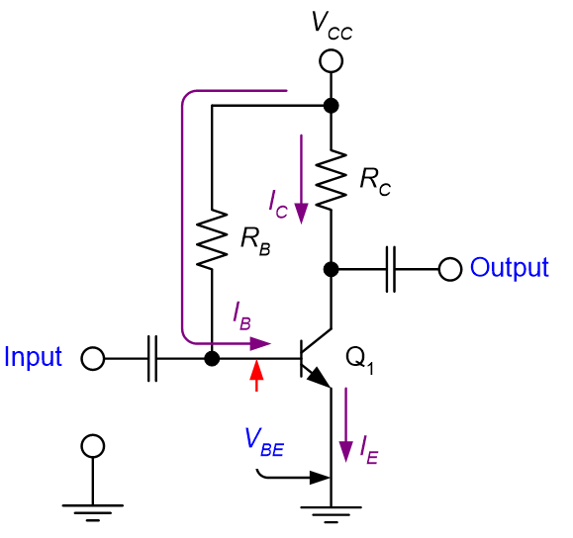
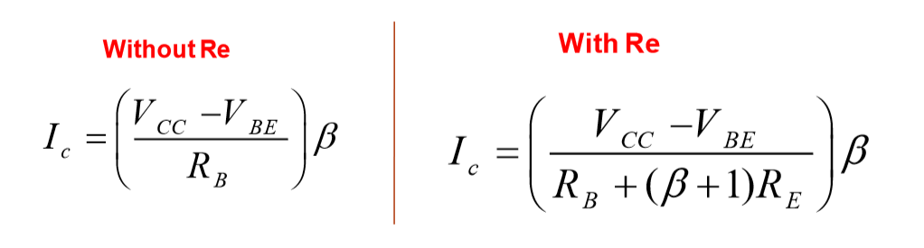
Increasing Biasing Stability

Slide 62
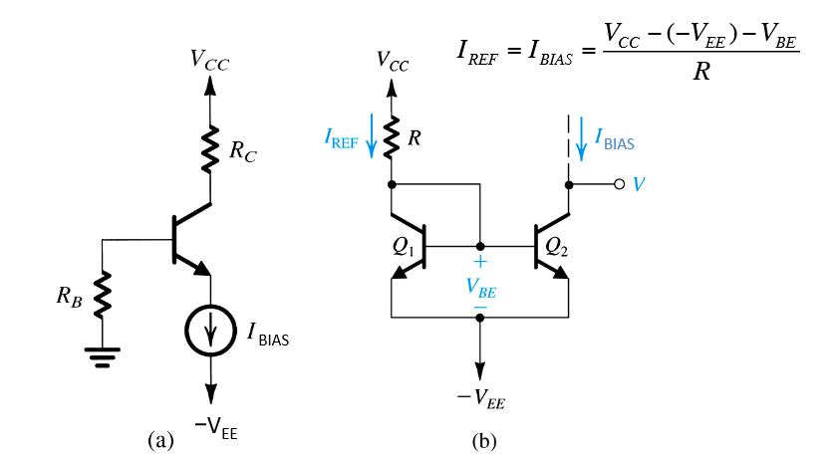
a) BJT biased using a constant-current source IBIAS b) Circuit for implementation the current source IBIAS

Slide 63


Slide 64



Slide 65





Slide 66


Slide 67

Find the value of β?

Slide 68


Slide 69


Slide 70


